Slide 1
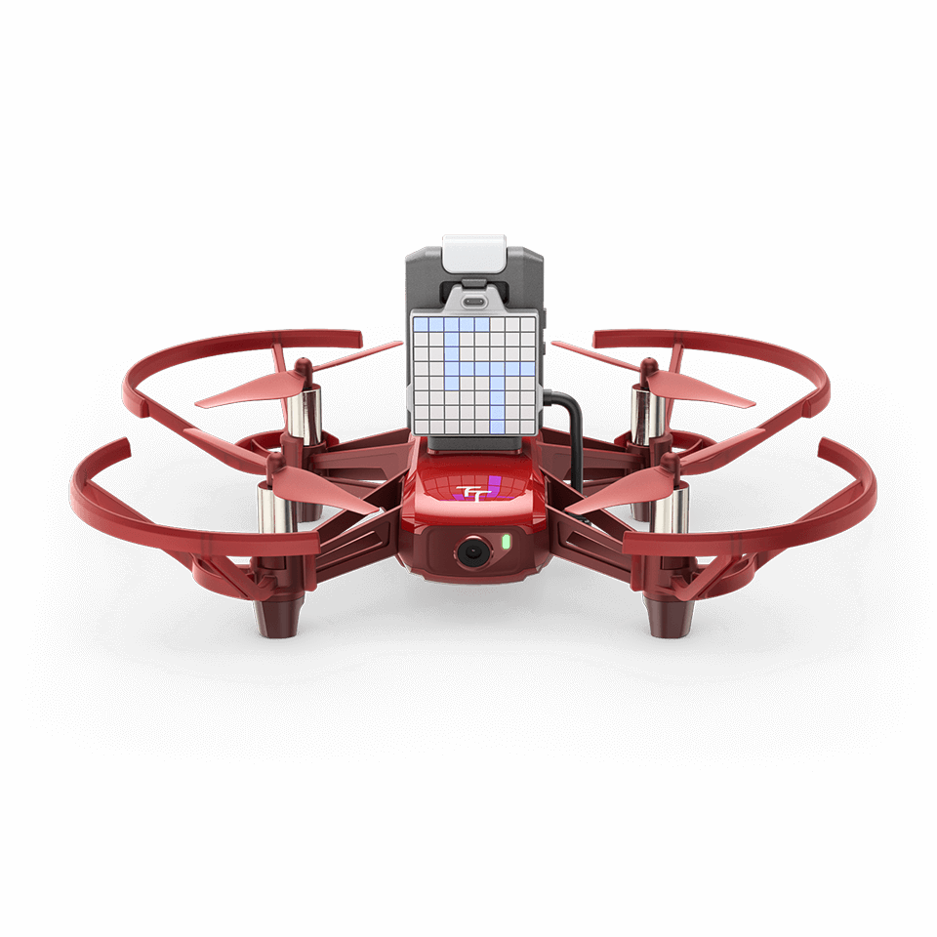
Drone tracking
Cappiello Marco
Eduardo Autore
2023/2024

Slide 2
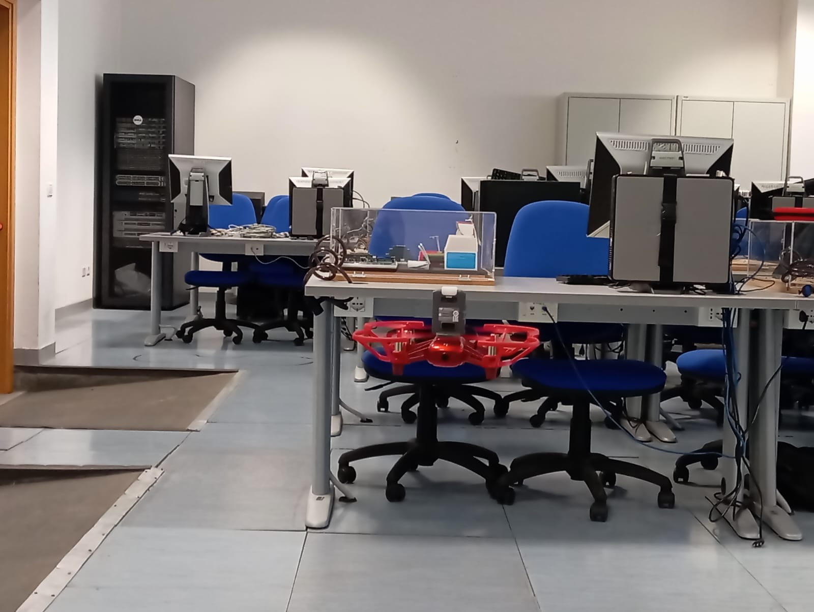
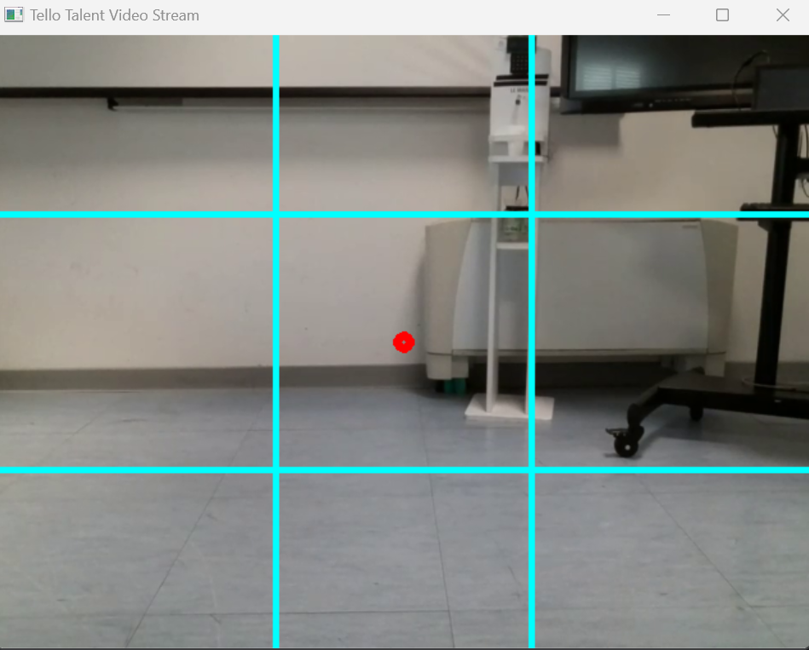
problem
Given two drones, create a program capable of recognizing the movement of one of the two and aligning with its position in flight.

Slide 3
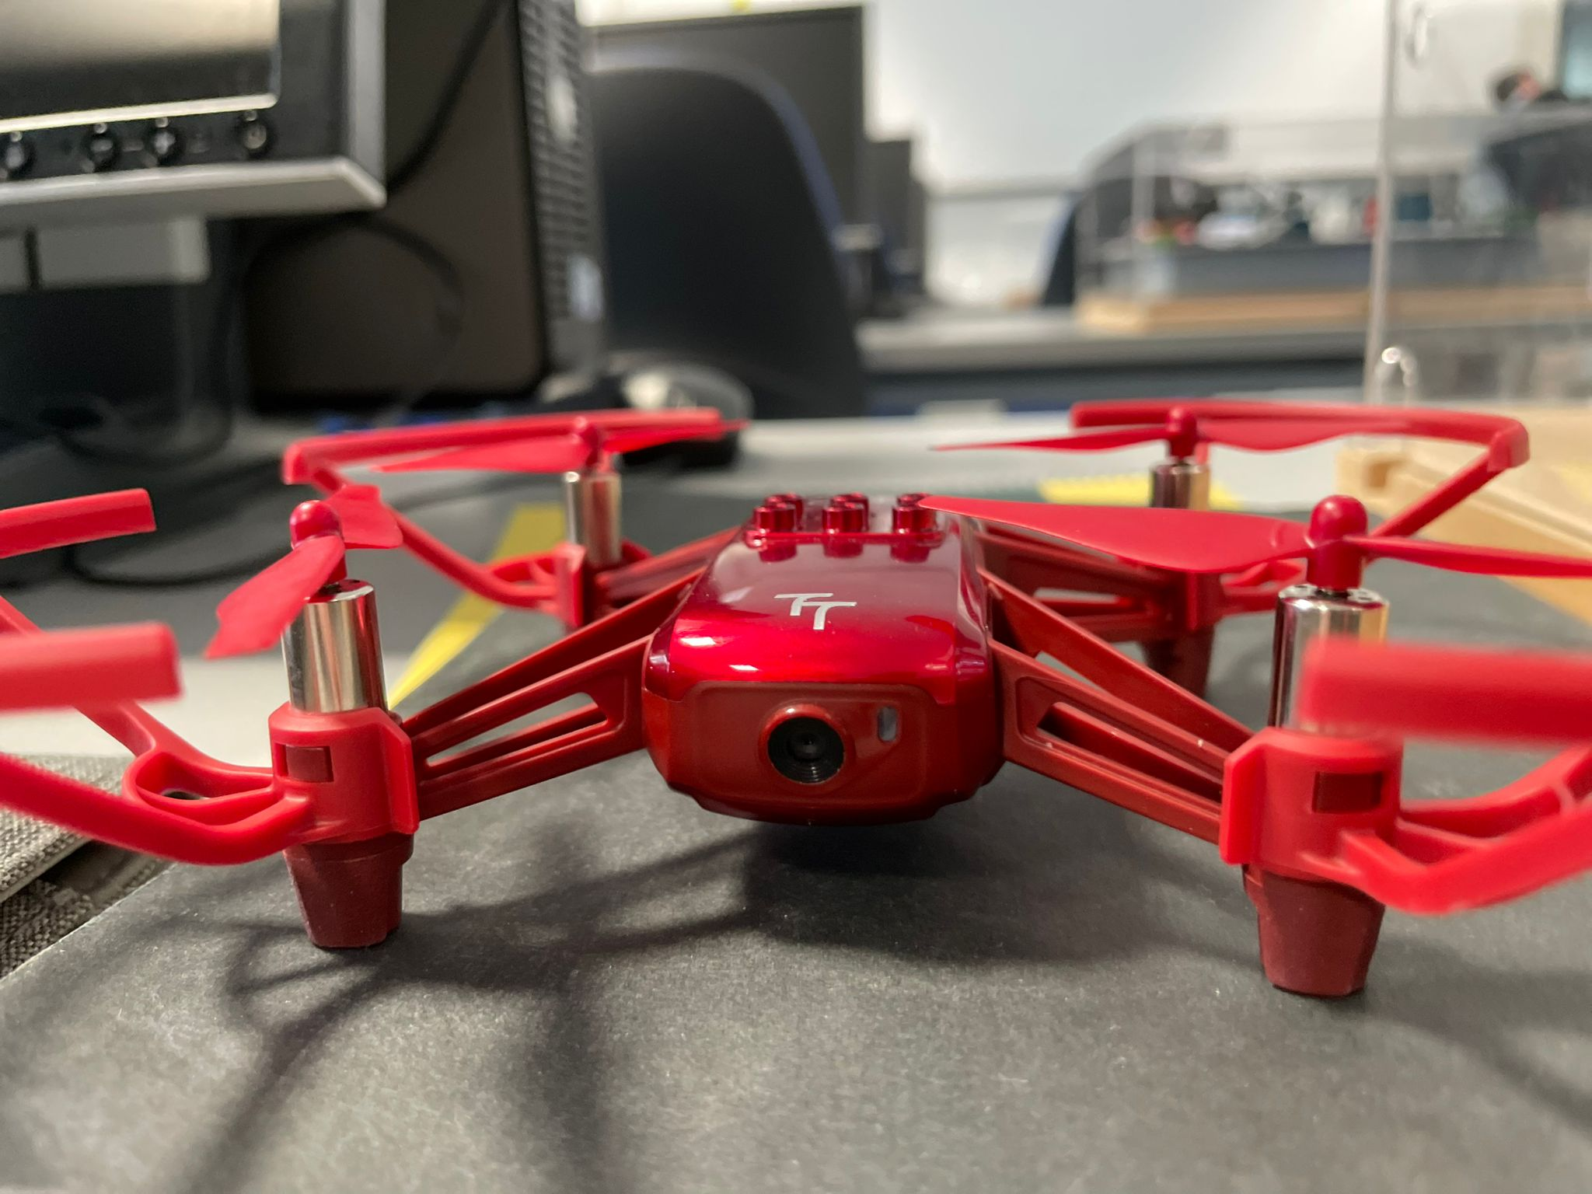
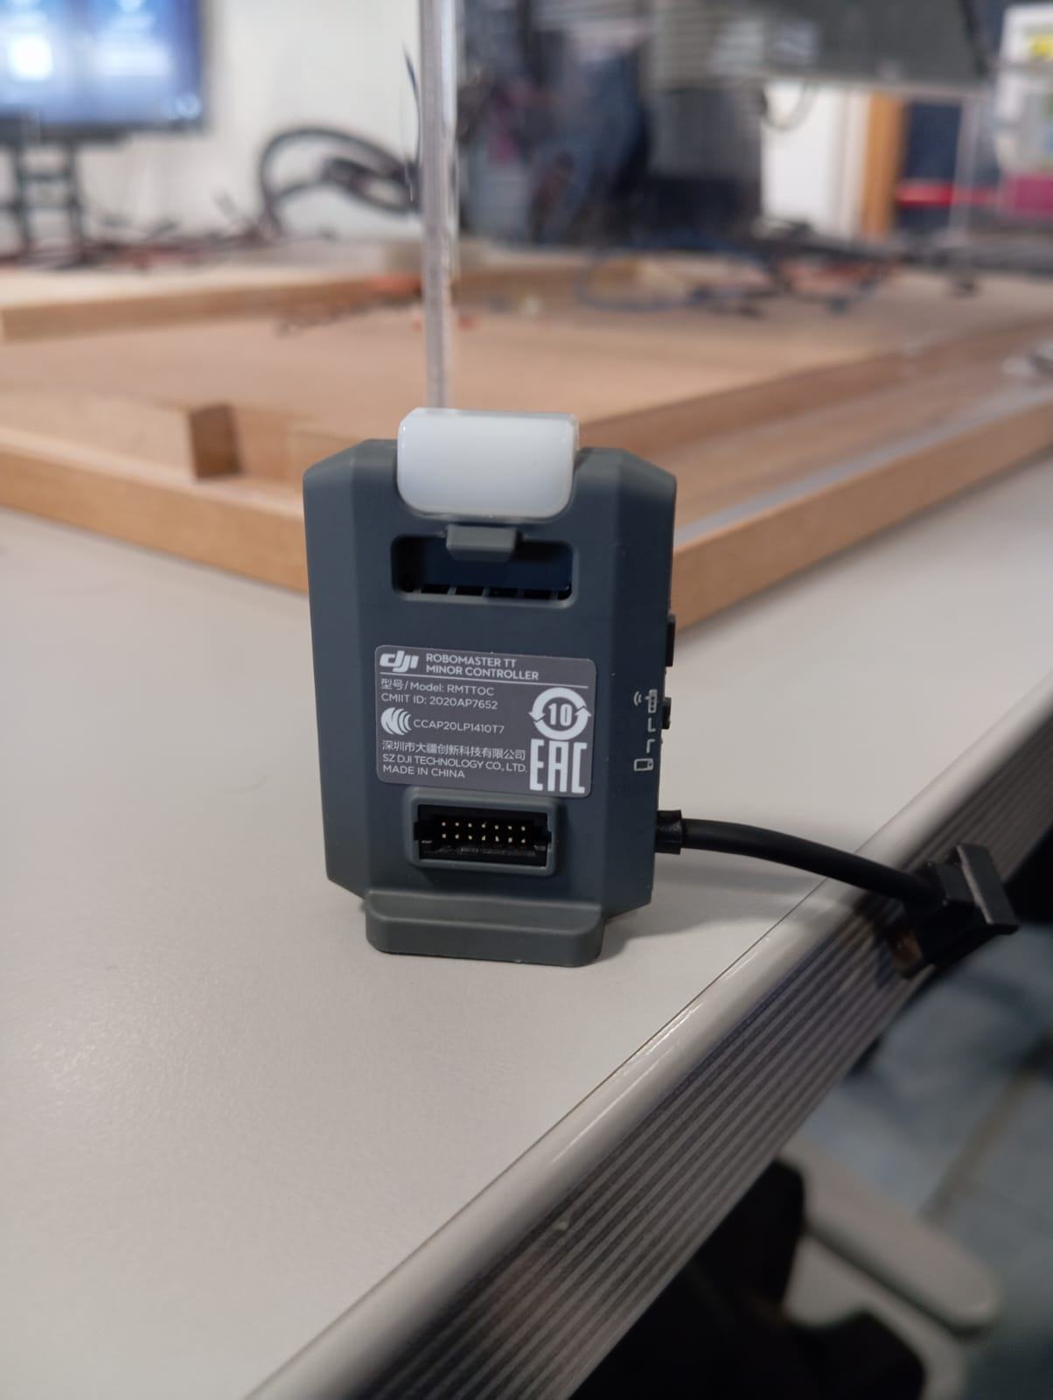
Hardware
The drones are tello talent
5 megapixel camera
expansion board with network board

Slide 4
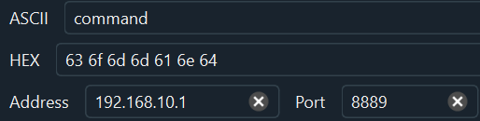
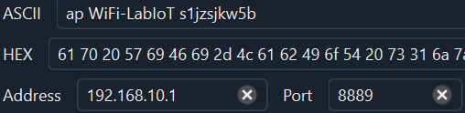
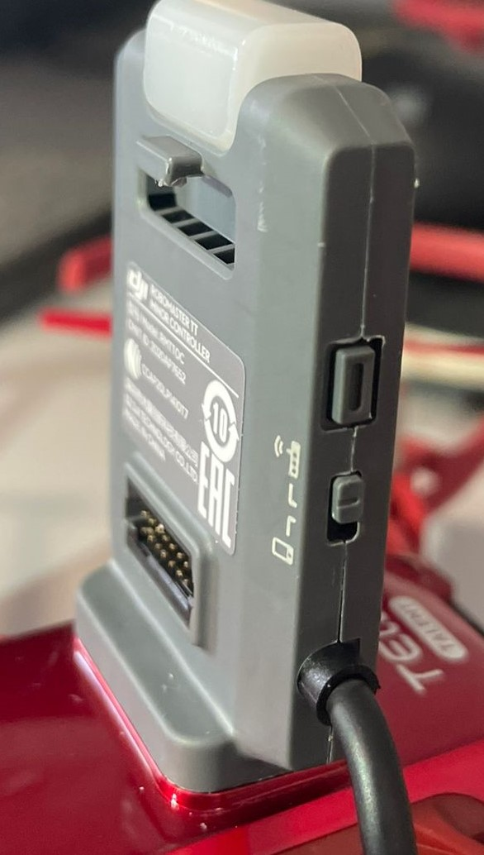
connection
To connect the drone to a WiFi network, you need to follow a simple procedure:Collegare la scheda di espansione al drone
Connect directly to the network generated by the drone.
Send a udp package «command» to ip 192.168.10.1 and port 8889
Send a udp package to «ap ssid password»
Turn off the drone, lift the switch on the expansion board and restart the drone

Slide 5
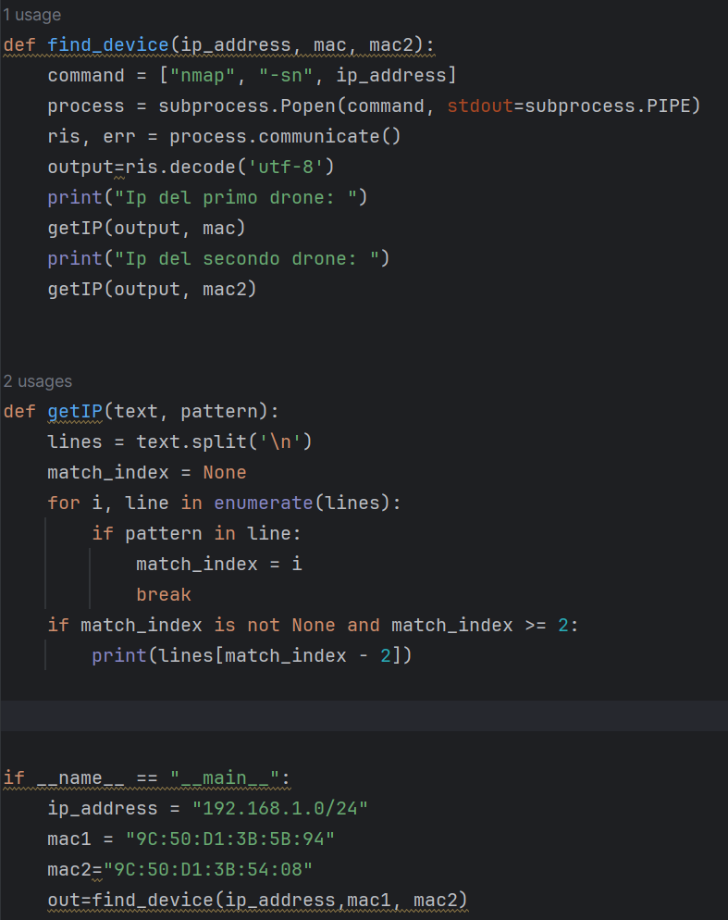
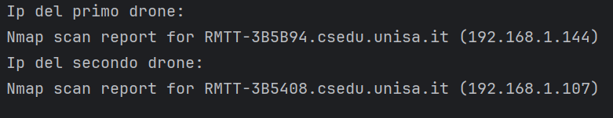
Recover the ip
Once the drone is connected to the WIFI, you need to retrieve its IP address (which cannot be set as fixed) using nmap. To do this, a regular expression has been used to find the IP within the output of nmap using the MAC address of the expansion board.

Slide 6
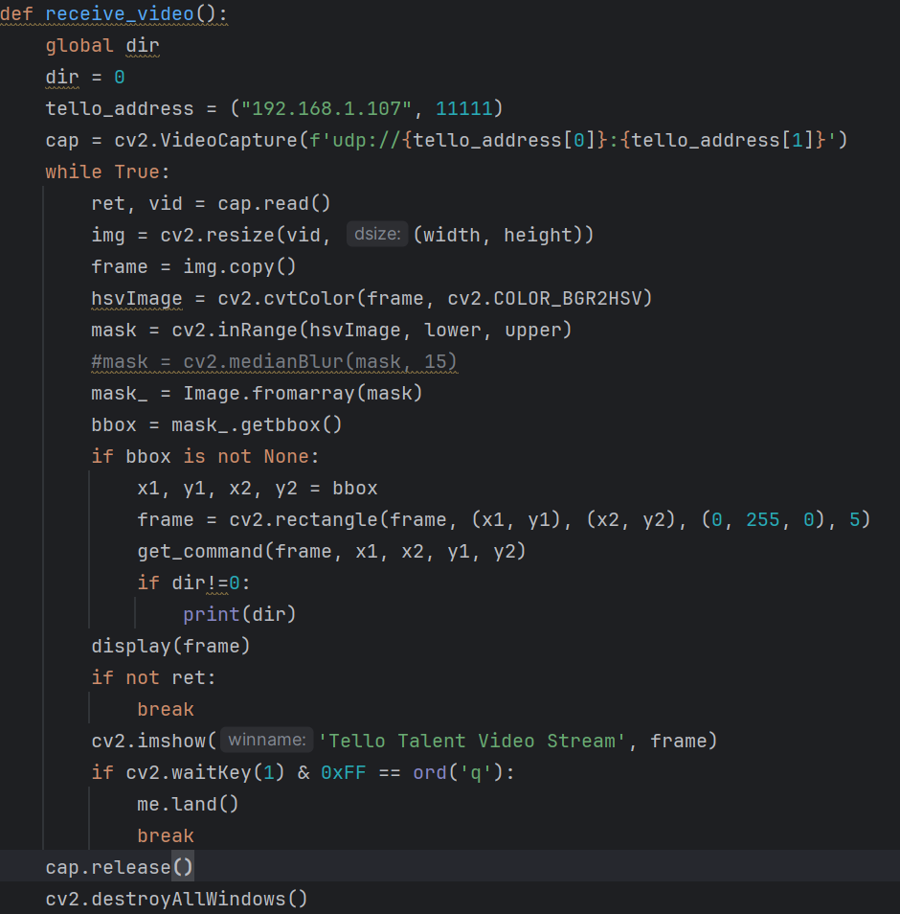
Software: streaming
The stream is received on port 11111 on a separate thread.
The cv2.medianBlur() function can be called to eliminate noise from the image.
A mask is applied to exclude all objects of non-red color with H: (150-179), S: (100-255), V: (100-255).

Slide 7
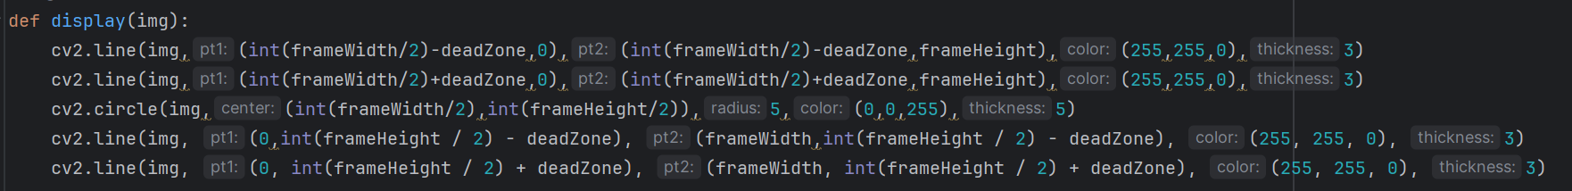
Software: video matrix
Grid applied on the stream video

Slide 8
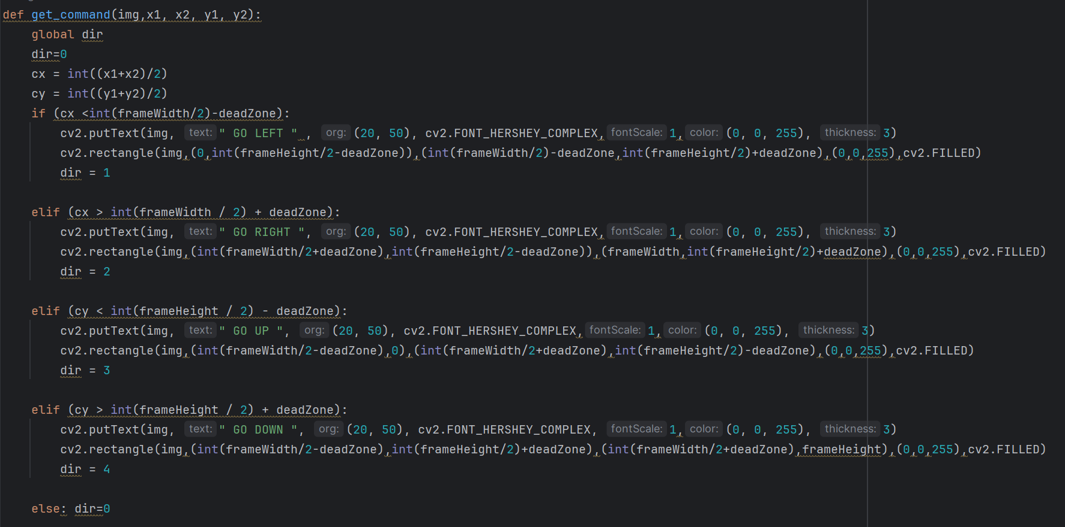
Software: get position

Slide 9
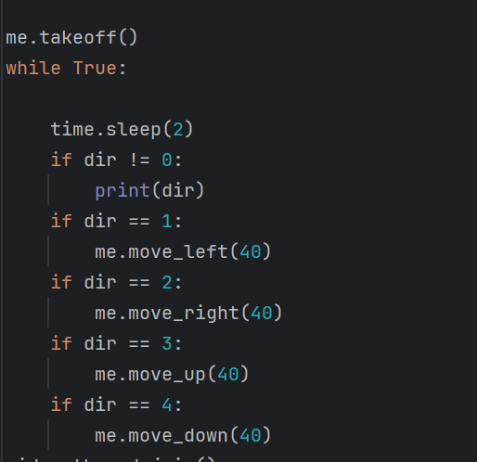
Software: send command

Slide 10
Conclusions
Applying the median filter (O(n^2log(n)) could eliminate the noise, but it might affect the performance of the program.
Color-based tracking is computationally efficient but may generate many false positives. An alternative approach could be to use YOLOv4 for real-time drone detection after appropriate training.
By modifying the 'deadzone' variable, the shape of the matrix and the resulting relative tracking can be altered.

Slide 11
Software: documentation
https://dl.djicdn.com/downloads/RoboMaster+TT/Tello_SDK_3.0_User_Guide_en.pdf
https://dl.djicdn.com/downloads/RoboMaster+TT/RoboMaster_TT_Tello_Talent_User_Manual_en.pdf
Github SDK python: https://github.com/damiafuentes/DJITelloPy
Github of the project: https://github.com/CapMark/TelloTalent-ColorDetection

